Slide 1

StudyCore
Intelligent Study Engine v1.0
A C++ Console Application
OOP • Design Patterns • Smart Timetable Generation
Built with C++ | Strategy & Facade Patterns
Notes:
Title slide introducing StudyCore — a C++ console application for intelligent study planning.

Slide 2




Project Overview
What is StudyCore?
Smart Algorithm
A C++ console app that helps students plan their exam study schedule intelligently based on subjects, deadlines, and weakness levels.
Automatically sorts subjects by exam date and distributes chapters across available days, reserving the last day for revision.
C++ OOP Design
Key Output
5 core classes using encapsulation, inheritance, abstraction, and polymorphism. Follows industry-grade design patterns.
Generates a per-day study plan with chapter targets, weak-subject warnings, heavy-load alerts, and revision days.
Notes:
Overview of what StudyCore does, why it's useful, and how it's built. 4 key pillars.

Slide 3





Features & Objectives
Student Profile
Subject Manager
Smart Timetable
Stores name & ID
Add, Edit, View, Delete
Auto day allocation
Progress Tracker
Input Validation
Study Tips
Chapter tracking
Robust error checks
Weakness-based hints
Notes:
6 core features of StudyCore shown as feature cards with icons.

Slide 4
OOP Concepts in StudyCore
Encapsulation
Inheritance
private:
string name;
int weaknessLevel;
public:
string getName();
void setName();
All Subject data is private. Access only through public getters/setters.
class TimetablePlanner
: public Planner {
void generatePlan(...)
override;
};
TimetablePlanner inherits from abstract Planner base class.
Polymorphism
Abstraction
Planner* strategy;
strategy->generatePlan();
// Calls correct version
// at runtime
Virtual function dispatch enables runtime polymorphism via Strategy pointer.
class Planner {
public:
virtual void
generatePlan(...) = 0;
virtual ~Planner() {}
};
Planner is an abstract interface — defines contract, hides implementation.
Notes:
All 4 pillars of OOP demonstrated with actual code snippets from the project.

Slide 5
Strategy Design Pattern
It separates the algorithm from the class that uses it. It consist of 3 parts:
Interface
Concrete Strategy
Strategy Context
This defines a common method for all strategies. Eg: CLASS 2: Planner — Strategy Interface (Abstract Base Class)
These are the different ways to do the same thing.
Eg: CLASS 3: TimetablePlanner — Concrete Strategy
This is the class that uses the strategy. Eg:
CLASS 4: StudyContext — Strategy Context

Slide 6
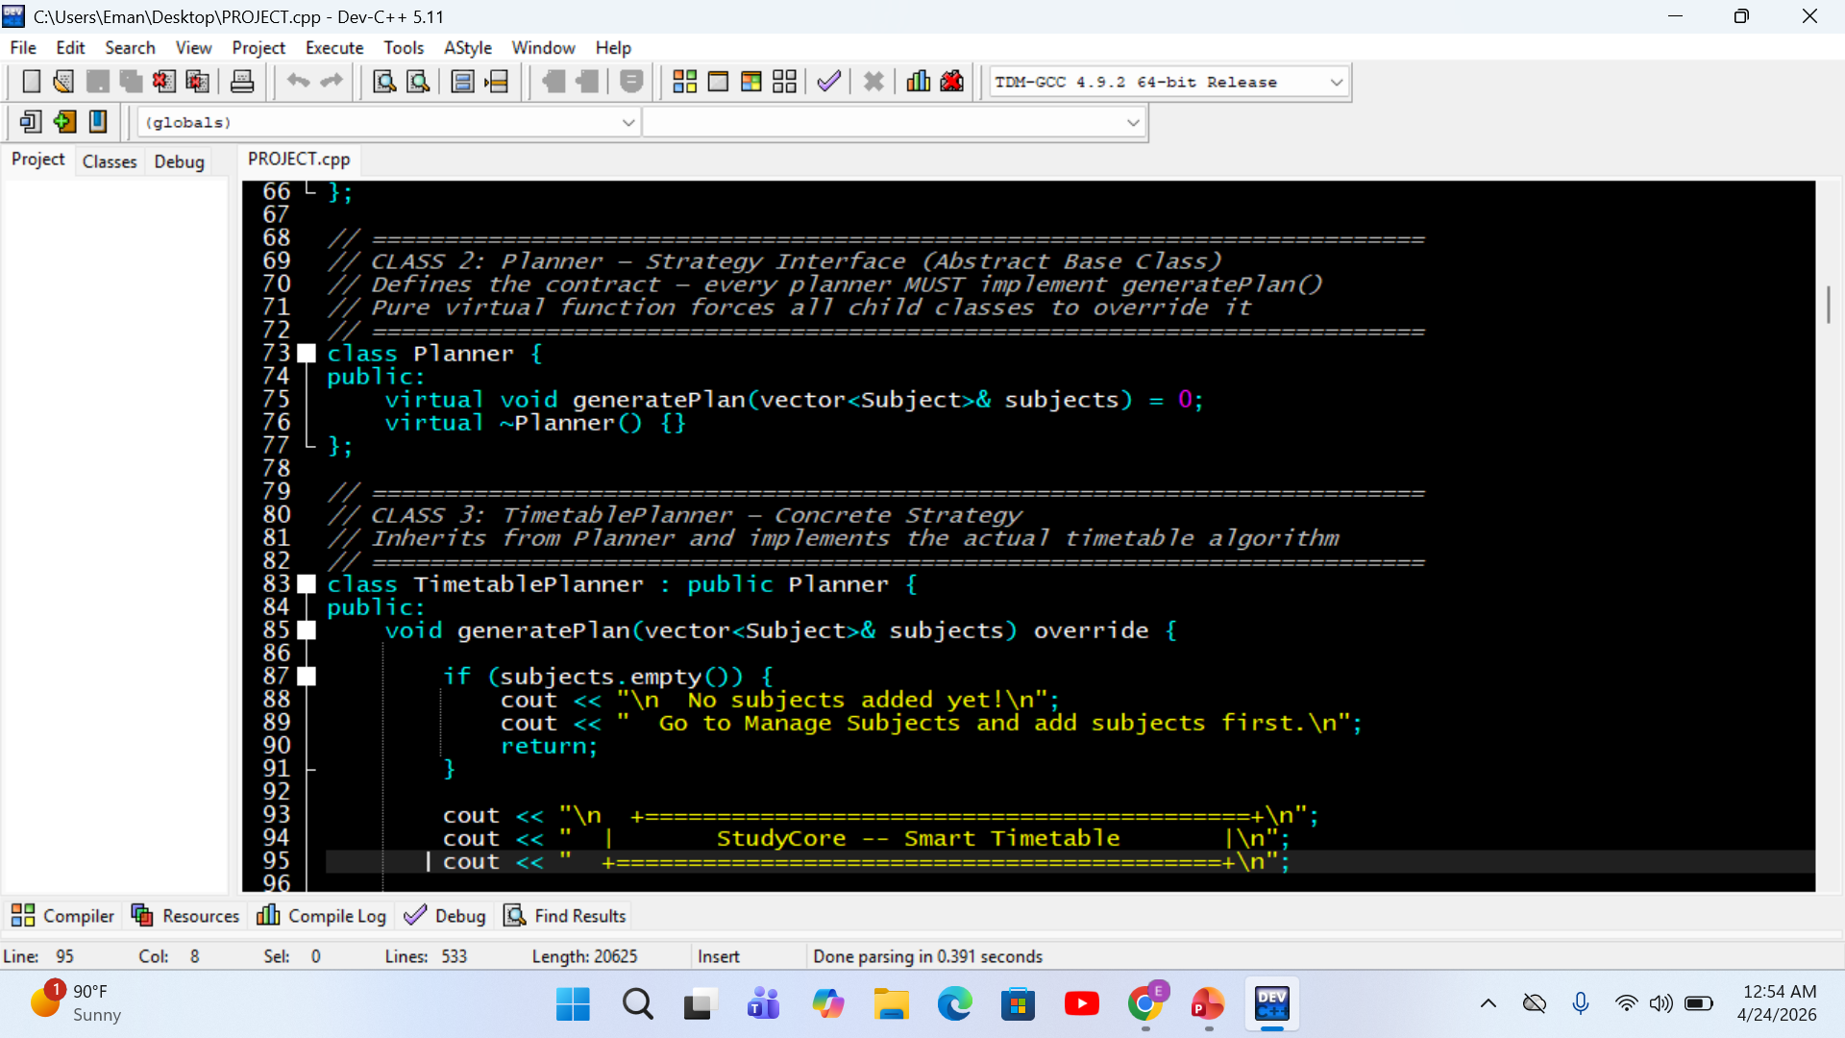
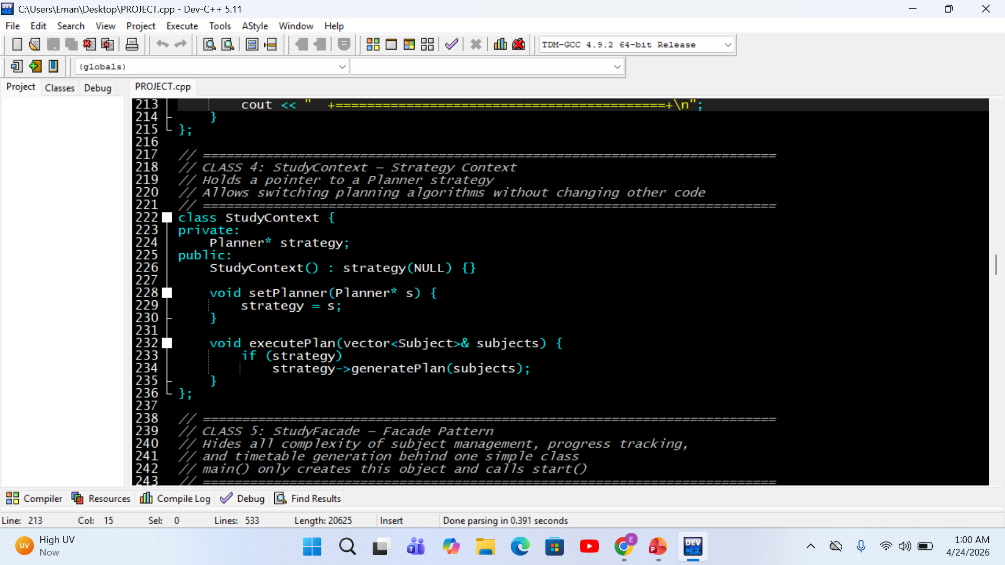
Strategy Design Pattern

Slide 7
Strategy Design Pattern
StudyContext
<<interface>>
Planner
Why Strategy?
✔ Swap planning algorithm
without changing code
✔ Open/Closed Principle
(extend, don't modify)
✔ Easy to add future
planning strategies
✔ Runtime flexibility
- strategy: Planner*
uses strategy
+ generatePlan()
vector<Subject>&) = 0
+ virtual ~Planner() {}
+ setPlanner(s: Planner*):void
+ executePlan(subjects : vector<Subject>&) : void
TimetablePlanner
+ generatePlan(subjects : vector<Subject>&) : void
Notes:
Strategy pattern: Planner interface, TimetablePlanner implementation, StudyContext holding the strategy.

Slide 8
Facade Design Pattern
The Facade Pattern is a structural design pattern that provides a simplified, unified interface to a complex system of classes,
Instead of interacting with multiple components directly, clients use a single “facade” class that handles the coordination behind the scenes.
This reduces complexity, improves readability, and decouples the client from subsystem details

Slide 9
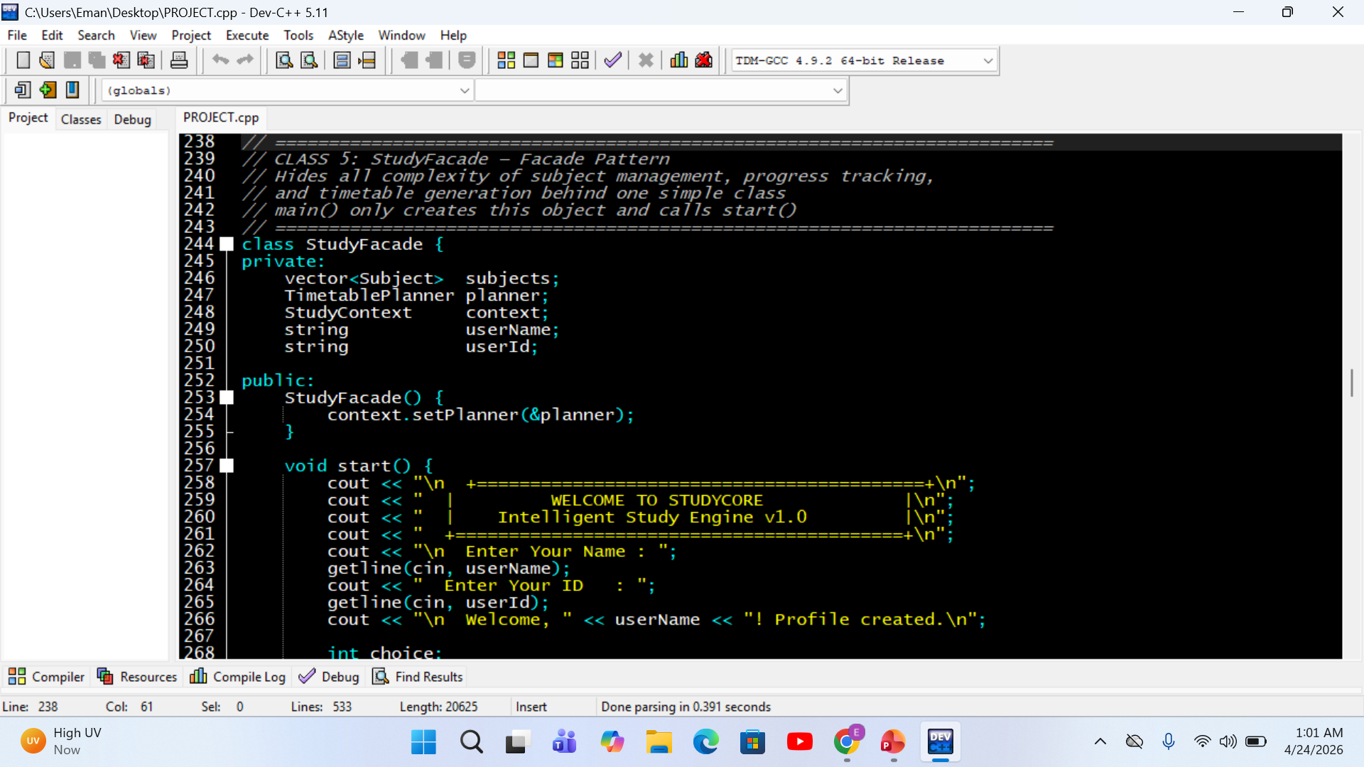
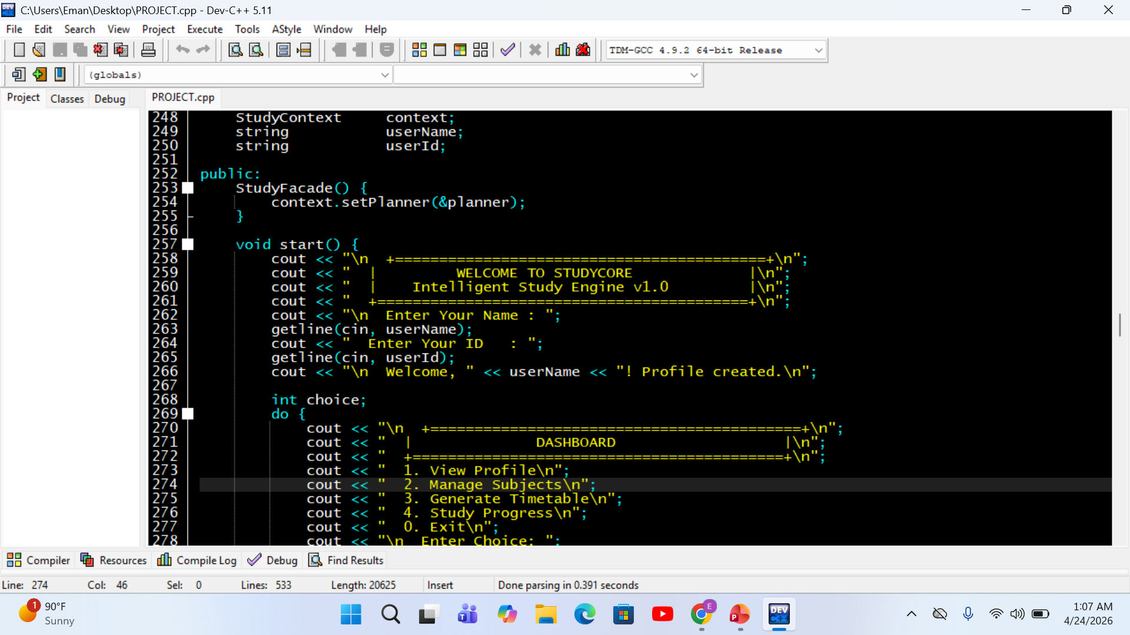
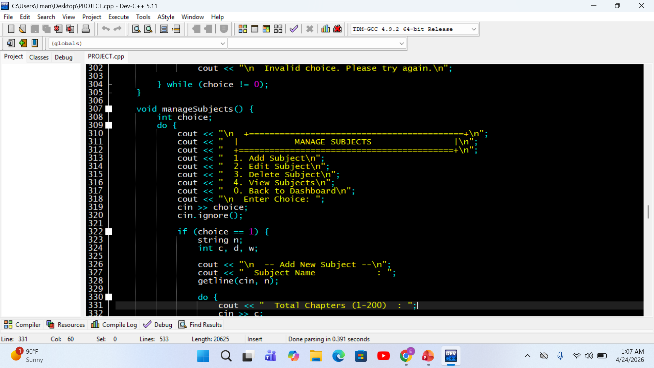
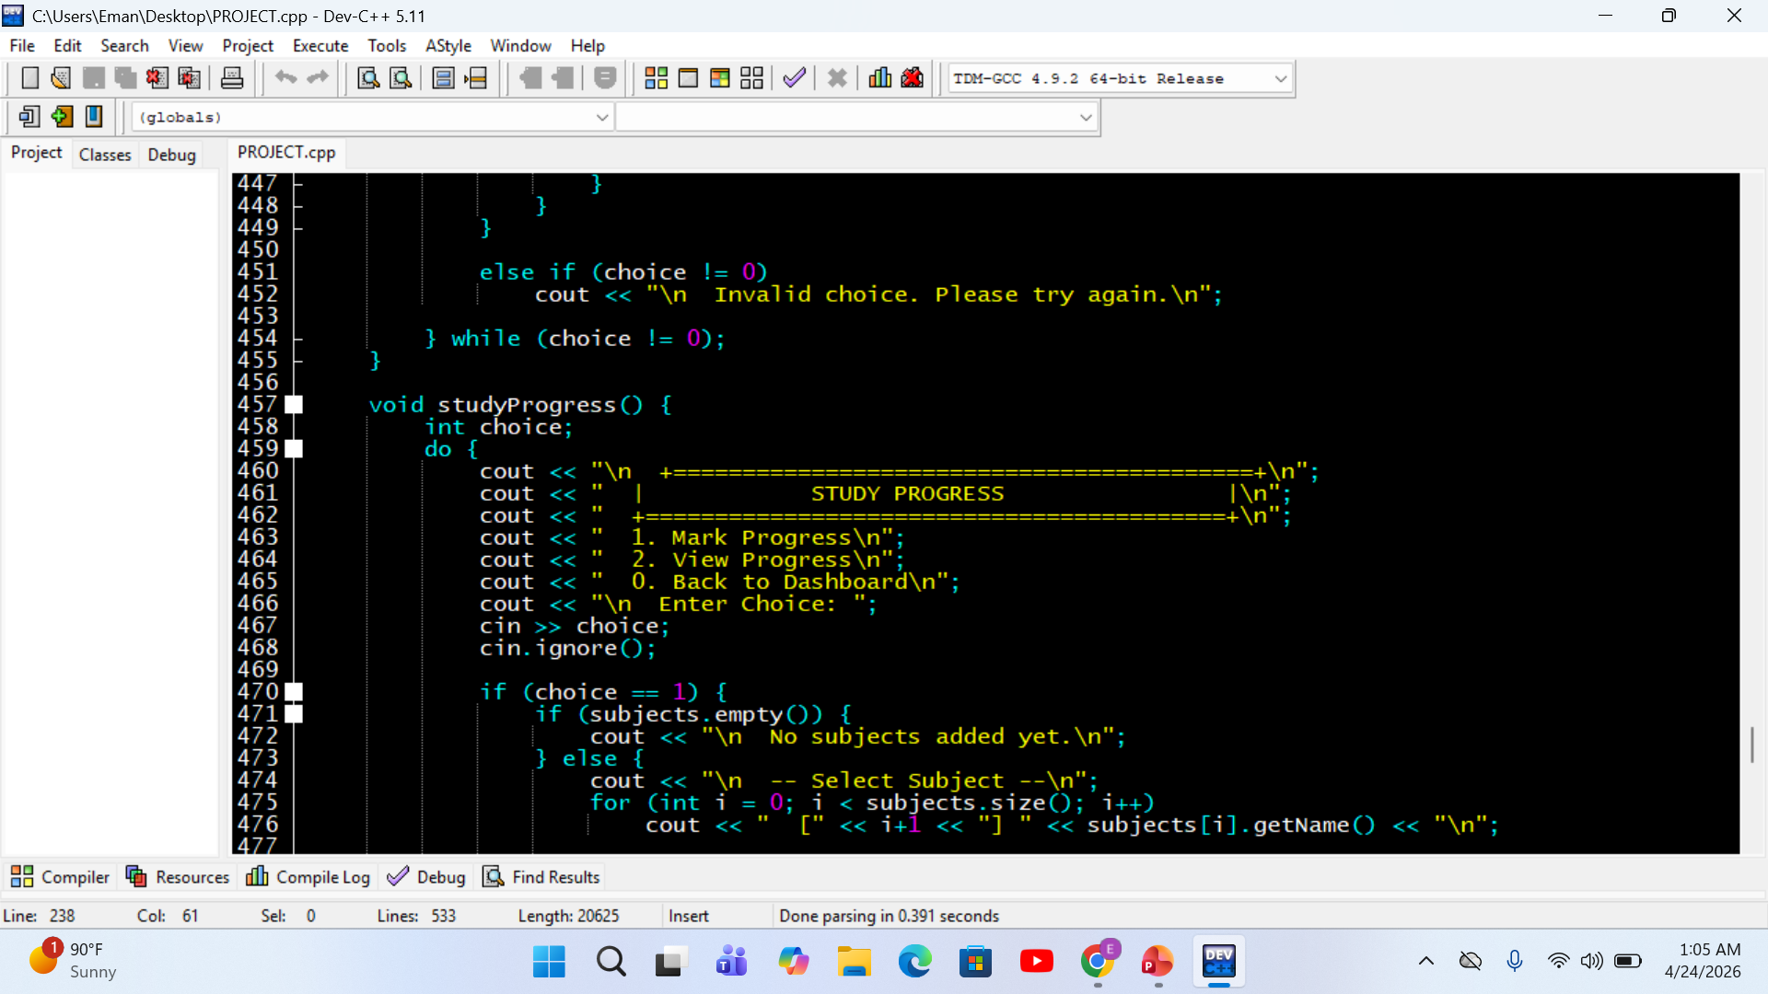
Facade Design Pattern

Slide 10
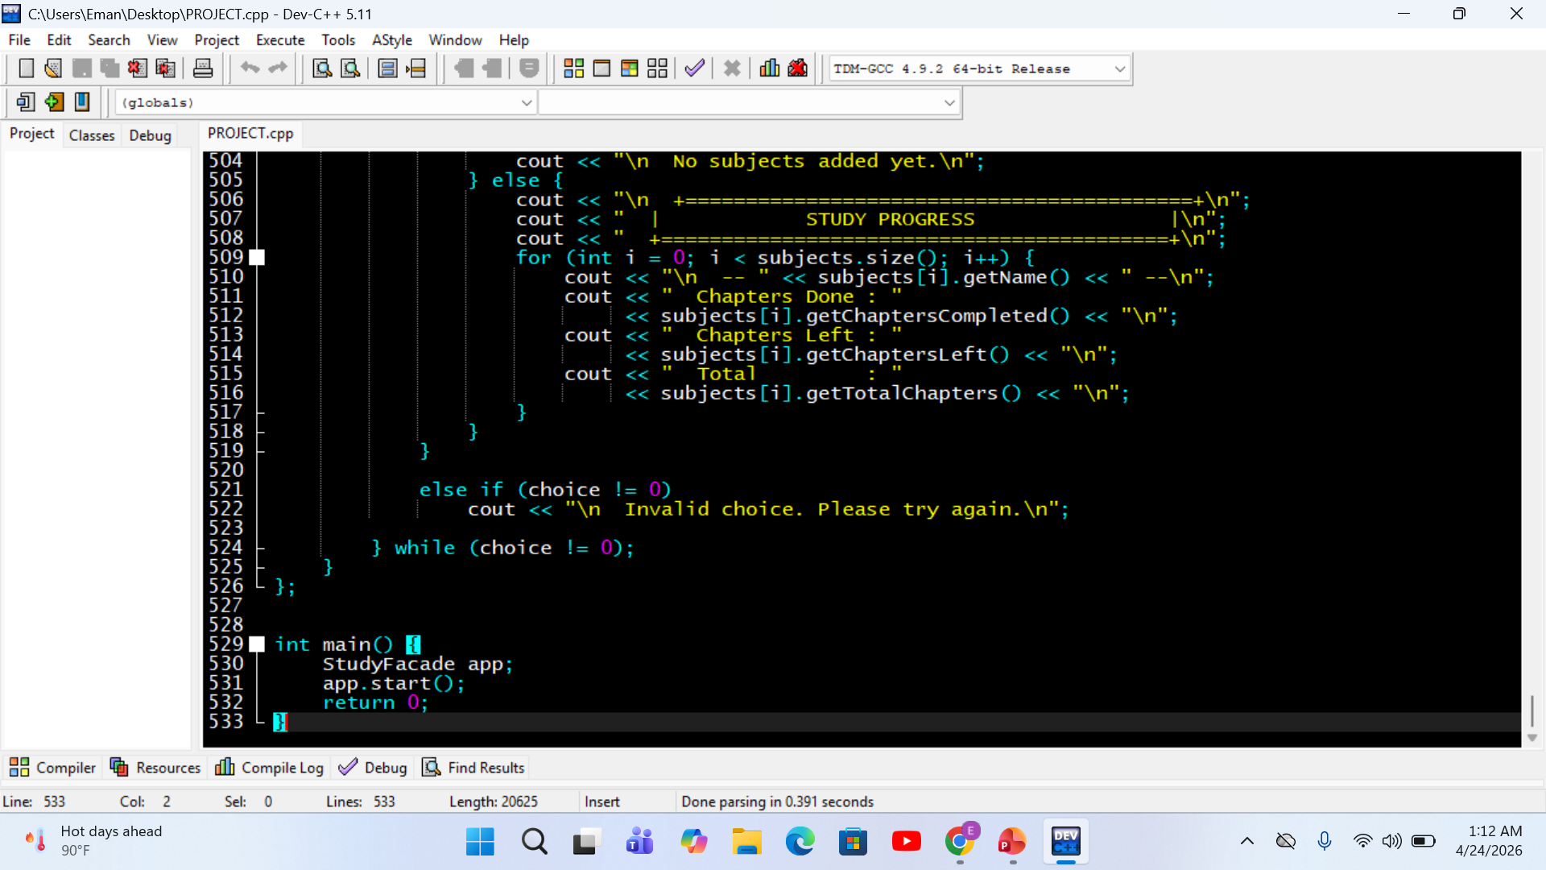
Facade Design Pattern

Slide 11
Facade Design Pattern
Subject
- name: string - totalChapters: int
- daysUntilExam: int
- weaknessLevel: int
chaptersCompleted: int
+ addProgress(n): void
+ display(): void
main()
StudyFacade
StudyFacade app;
app.start();
- subjects: vector<Subject>
- planner: TimetablePlanner
- context: StudyContext
- userName, userId : string
+ start() : void
+ manageSubjects(): void
+ studyProgress(): void
TimetablePlanner
+ generatePlan(subjects : vector<Subject>&) : void
StudyContext
- strategy: Planner*
+ setPlanner(s: Planner*):void
+ executePlan(subjects : vector<Subject>&) : void
✔ Facade hides all complexity — main() only needs 2 lines to run the entire application
Notes:
Facade pattern: StudyFacade wraps all subsystem complexity. main() is just 2 lines.

Slide 12
Class Diagram — System Architecture
Subject
<<interface>>
Planner
- name: string
+ generatePlan()
- totalChapters: int
(pure virtual)
- daysUntilExam: int
+ ~Planner()
- weaknessLevel: int
- chaptersCompleted: int
TimetablePlanner
+ getName()
+ addProgress()
+ generatePlan() override
+ display()
-- Bubble sort
-- Smart allocation
StudyFacade
StudyContext
- subjects: vector
- strategy: Planner*
- planner
+ setPlanner()
- context
+ executePlan()
+ start()
+ manageSubjects()
+ studyProgress()
Notes:
UML-style class diagram showing all 5 classes, their members, and relationships.

Slide 13
Code Walkthrough — Key Functions
addProgress() — Validation
Strategy executePlan()
void addProgress(int count) {
int remaining = totalChapters
- chaptersCompleted;
while (count < 1 || count > remaining) {
cout << "Only " << remaining
<< " left! Re-enter: ";
cin >> count;
}
chaptersCompleted += count;
}
void executePlan(
vector<Subject>& subjects) {
if (strategy)
strategy->generatePlan(subjects);
}
// Context delegates to:
// TimetablePlanner::generatePlan()
// via virtual dispatch
Guards input — loops until valid entry. Never overwrites more than remaining chapters.
Decouples caller from algorithm. strategy pointer enables runtime swap.
Notes:
Deep dive into two critical functions: addProgress with validation and executePlan with strategy dispatch.

Slide 14
Timetable Algorithm — Flowchart
Start: subjects list
Smart Allocation Logic
Case 1: daysLeft == 1
Is subjects empty?
Yes
Print: Day 1 = Revise everything
Print: No subjects!
Case 2: All chapters done
No
Print: All days = Revision
Bubble Sort by daysUntilExam
Case 3: Normal smart calc
chaptersPerDay = max(1, chapLeft/days)
For each subject →
Extra chapters spread
First N days get +1 extra chapter each
chaptersLeft == 0?
Last day = always Revision
Yes
*** REVISION DAY *** reserved always
No
Weakness check
Print: All days Revision
≥7: [Focus Hard!] ≥8: Start first each day
Notes:
Algorithm flow: bubble sort by exam date, then smart chapter allocation with edge case handling.

Slide 15






System Flow — User Interaction
1
2
3
4
5
6
Enter Profile
Dashboard
Add Subjects
Track Progress
Generate Plan
Study Success!
Name & Student ID
4 main options
Chapters, days, weakness
Mark chapters done
Smart timetable
Stay consistent
Key Program Details
5 classes — each with single responsibility
do-while loops for menu navigation
vector<Subject> stores all subject data
Bubble sort for exam priority ordering
Input validated at every entry point
Strategy pattern for swappable algorithms
Notes:
Full user journey from login to timetable generation. Key program design details below.

Slide 16
Sample Console Output
StudyCore Terminal
Timetable Output
+==========================================+
==========================================
| WELCOME TO STUDYCORE |
Subject : Mathematics
| Intelligent Study Engine v1.0 |
==========================================
+==========================================+
Chapters Left : 8
Days Until Exam : 5
Enter Your Name : Ahmed
Study Days : 4
Enter Your ID : CS-2024
Revision Days : 1
Welcome, Ahmed! Profile created.
Day 1 : Chapter 1 to 2 [ Weak - Focus! ]
+==========================================+
Day 2 : Chapter 3 to 4
| DASHBOARD |
Day 3 : Chapter 5 to 6
+==========================================+
Day 4 : Chapter 7 to 8
1. View Profile
Day 5 : *** REVISION DAY ***
2. Manage Subjects
3. Generate Timetable
Tip: Weakest subject - start first.
4. Study Progress
0. Exit
Timetable Ready! Stay Consistent!
Notes:
Two terminal windows showing welcome screen and a generated timetable for Mathematics with 8 chapters in 5 days.

Slide 17




Conclusion
Demonstrates all 4 pillars of OOP in C++
Implements Strategy + Facade design patterns
Smart timetable algorithm with edge-case handling
Robust input validation throughout
Clean, extensible architecture for future enhancements
StudyCore — Built in C++ | 5 Classes | 2 Design Patterns | 1 Smart Algorithm
Notes:
Summary of project achievements: OOP, patterns, algorithm, validation, and architecture.

